Slide 1
Behavioural Finance
8. Socio-cultural Biases & Social Norms
Antonio Silva, May 2023

Slide 2
Outline
Lesson 8
Socio-cultural biases
Social Norms

Slide 3

Heuristics
Behavioural Bias
Representativeness
Cognitive Bias
Availability
Emotional Bias
Anchoring
Social-cultural bias
Affect
Behavioural Finance | Sandra Maximiano Lecture 4|Nov 11 2021
Notes:
The first 3 can lead to biases and systematic errors
The 4th relates to how people feel.

Slide 4
Socio-cultural biases
Tendency to interpret and judge information or behavior based on one's own cultural or social norms, often leading to unfair or inaccurate assessments of others who come from different cultural or social backgrounds.
Notes:
Have you ever made an investment decision based on how you feel about a company, its products, or its leadership?

Slide 5
Cultural biases
Research shows that culture has a direct impact on expectations and preferences, which in turn affect economic outcomes. Humans have a tendency to prefer people who are like them – in-group bias - which affects the way people view the world. This causal relation emerges through trust and coordination.

Slide 6
Cultural biases
Trust
Trust affects the willingness to exchange financial assets.
Trust reduces trade frictions - > if you trust someone and they’re trustworthy, you won’t be ripped off and can reduce enforcement costs (e.g. contracts)
Humans have the tendency to trust people from their group over people from different groups.

Slide 7
Cultural biases
Trust
Investors are more likely to own stocks in firms that communicate in the investor’s native tongue and that have a chief executive of the same cultural background.
Investors tend to allocate less money to an index fund operated by managers with foreign sounding names.

Slide 8
Cultural biases
Coordination
Coordination means you have similar expectations when exchanging goods, e.g. you expect to be paid in 30 days vs 90 days, or you expect to be paid a bribe or not
People from the same culture are more likely to share the norms and behaviours, so it’s easier to achieve coordination and reduce trade frictions.

Slide 9
Home bias
Investors are generally drawn to companies that are located close to them, communicate in the same language, and have chief executives from similar cultural backgrounds.
Notes:
Have you ever made an investment decision based on how you feel about a company, its products, or its leadership?

Slide 10
Social norms
Social norms are the unwritten rules of behaviour that are considered acceptable in a group or society. Norms function to provide order and predictability in society.
Descriptive norms: normative behaviour, inferred by what people actually do.
Injunctive norms: Normative value, based upon accepted understanding of what is appropriate and moral.
Notes:
Descriptive norm – e.g. everyone starts clapping, you do too.
Injunctive norm – you walk into a library, and start whispering, because it’s expected that you should.
There’s often an overlap – you wear smart clothes to an interview, both because everyone else is, and because it’s considered the correct and appropriate thing to so. However the force of influence is different (are you doing it because everyone else is? Or are you doing it because it’s the accepted, appropriate thing to do? Or both?)
Norms arise though ‘social exposure’ – collective term for exposure to certain behaviours or beliefs, i.e. what we see people doing around us, friends & family, people on the street, mass media, all aspects of social culture.
Start of talking about 3 classic experiments in social influence.

Slide 11
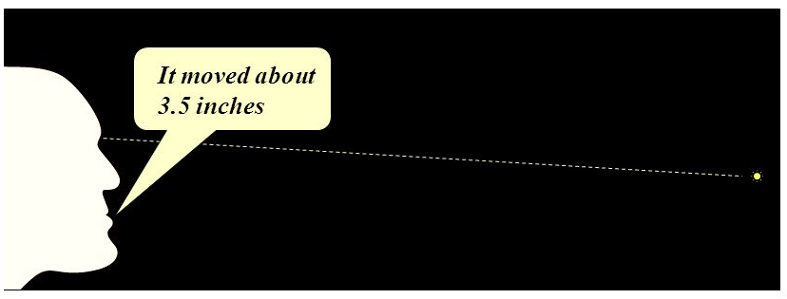
Sherif’s Autokinetic Effect (1936)
A stationary dot of light in a dark room will appear to move
Participants were asked how far they thought the dot moved, first alone, and then in groups of three

Slide 12
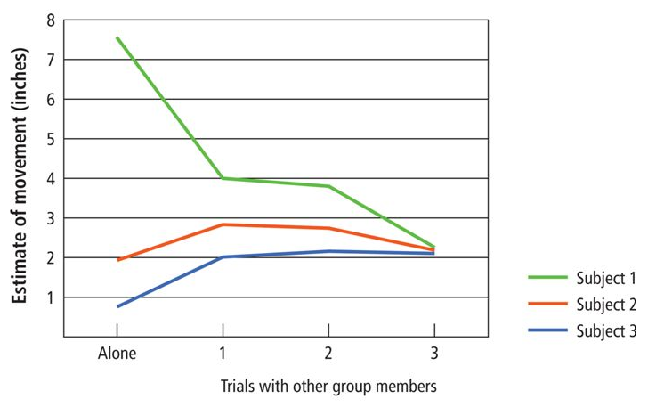
Sherif’s Autokinetic Effect
Alone condition: Over successive guesses they settled on a consistent, individual estimate. But participants differed from each other.
Group condition: Initial estimates differed, but soon converged to a group norm.
Notes:
Tested individually after exposure to the group condition, participants gave the same estimates as they are reached in their prior group condition.
The experiment showed that people look to others for guidance when they face ambiguous situations (like the autokinetic effect).
When people don't have all the information they need, they look to others for information. This is called informational conformity.
Participants' estimates converged and a group norm formed because participants were influenced by other participants' estimates. They were influenced by informational social influence.

Slide 13
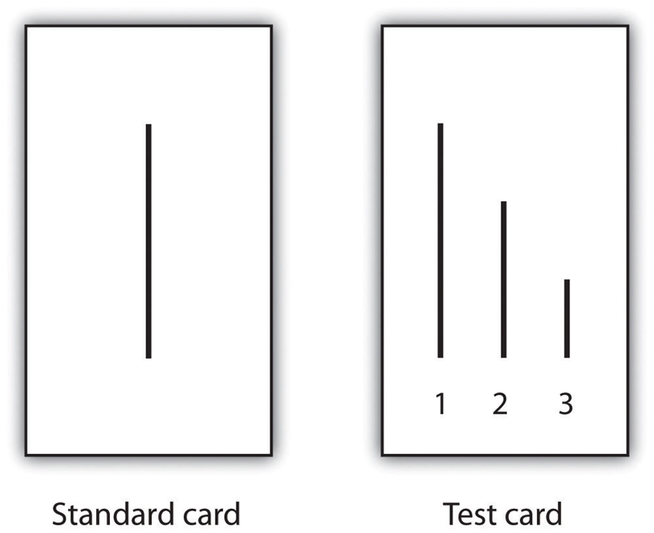
Asch’s Conformity Studies (1956)
13% of participants conformed in at least 10 out of 12 trials
76% of people conformed at least once

Slide 14
Asch’s Conformity Studies (1956)
What’s going on?
Post-experimental interviews suggest at least two types of conformity:
Most participants claim to have ‘known’ that the majority was wrong, but conformed anyway through fear of embarrassment, desire to fit in, or to meet perceived expectations -> Compliance.
Some genuinely believed the majority to be right -> Internalisation. Of these:
  Some felt initial disagreement but believed ‘several pairs of eyes must be better than one’ – > distortion of judgement
  Others ‘saw’ the majority’s answer as correct – > distortion of perception

Slide 15
Dual-process model of conformity
Deutsch & Gerard, 1955
Normative Social Influence | Informational Social Influence
Public compliance without private belief | Private internalisation (social proof)
Relationship motives: A ‘need to be liked’ / fit-in / be accepted / social harmony | Epistemic motives: A ‘need to be right’. Social environment is a source of information.
Public self – identity management, status, acceptance | Private self – self-concept, beliefs and attitudes
Mediated by social status, size of majority, proximity of majority, and public surveillance. | Mediated by credibility/expertise of majority or minority (including size)
Notes:
Now, here is a way of understanding why people conforming using two models.

Slide 16
Social Identity Theory (1958)
Social Identity Theory proposes that individuals derive a significant part of their self-concept from their membership in social groups.
People categorize themselves and others into various groups based on characteristics like ethnicity, nationality, religion, or even sports team affiliation.
They then tend to favor their in-group, which can lead to intergroup conflict and discrimination.
Notes:
And there’s also third model that is useful to understand conformity:
Social Identity Theory, proposed by psychologist Henri Tajfel, suggests that individuals derive a significant part of their self-concept from their membership in social groups. According to this theory, people categorize themselves and others into various groups based on characteristics like ethnicity, nationality, religion, or even sports team affiliation. They then tend to favor their in-group, seeing it as superior to out-groups. This ingroup favoritism can lead to intergroup conflict and discrimination. Social Identity Theory also posits that individuals may engage in social comparison, seeking to enhance their self-esteem by positively differentiating their group from others. Overall, it highlights the role of group membership in shaping perceptions, attitudes, and behaviors.

Slide 17
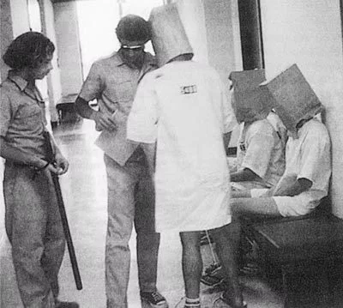
Zimbrano’s prison experiment (1971)
24 young, healthy, psychologically normal men were randomly assigned to be “prisoners” or “guards” in a simulated prison environment.
Experiment had to be terminated after only 6 days due to the extreme, pathological behavior emerging in both groups.
Pacifist young men assigned as guards began behaving sadistically, inflicting humiliation and suffering on the prisoners. Prisoners became blindly obedient and allowed themselves to be dehumanized.
Study demonstrated the power of situations to alter human behaviour dramatically. Even good, normal people can do evil things when situational forces push them in that direction.
Notes:
The experiment was conducted in 1971 by psychologist Philip Zimbardo to examine situational forces versus dispositions in human behavior.
24 young, healthy, psychologically normal men were randomly assigned to be “prisoners” or “guards” in a simulated prison environment.
The experiment had to be terminated after only 6 days due to the extreme, pathological behavior emerging in both groups. The situational forces overwhelmed the dispositions of the participants.
Pacifist young men assigned as guards began behaving sadistically, inflicting humiliation and suffering on the prisoners. Prisoners became blindly obedient and allowed themselves to be dehumanized.
The principal investigator, Zimbardo, was also transformed into a rigid authority figure as the Prison Superintendent.
The experiment demonstrated the power of situations to alter human behavior dramatically. Even good, normal people can do evil things when situational forces push them in that direction.

Slide 18
Dual-process model of conformity
Normative Social Influence | Informational Social Influence
Public compliance without private belief | Private internalisation (social proof)
Relationship motives: A ‘need to be liked’ / fit-in / be accepted / social harmony | Epistemic motives: A ‘need to be right’. Social environment is a source of information.
Public self – identity management, status, acceptance | Private self – self-concept, beliefs and attitudes
Mediated by social status, size of majority, proximity of majority, and public surveillance. | Mediated by credibility/expertise of majority or minority (including size)

Slide 19
Triple-process model of conformity
Normative Social Influence | Informational Social Influence
Identification
Public compliance without private belief | Private internalisation (social proof)
Assimilation of group norms
Relationship motives: A ‘need to be liked’ / fit-in / be accepted / social harmony | Epistemic motives: A ‘need to be right’. Social environment is a source of information.
Existential motives: A need to self-define. We define ourselves by group membership.
Public self – identity management, status, acceptance | Private self – self-concept, beliefs and attitudes
Social Self (group-based identity)
Mediated by social status, size of majority, proximity of majority, and public surveillance. | Mediated by credibility/expertise of majority or minority (including size)
Mediated by perceived in-group/out-group relationship of influencing agent
Notes:
Identification is a third form of social influence,
But it can also be construed as a strong mediating factor on normative & information influence (in-group status/shared identify strengthens influence)

Slide 20
Milgram’s obedience studies (1963)
Experiment to investigate the extent to which individuals would obey authority figures, even when their actions conflicted with their personal conscience.
Participants were told they were taking part in a study on memory and learning, but the real focus was on their willingness to administer electric shocks to another person (a confederate) when instructed by an authority figure (the experimenter).
The shocks were fake, but participants believed they were real, and the confederate would act as if they were experiencing pain.
Despite expressing discomfort and moral objections, a significant proportion of participants continued to administer shocks up to the highest levels, obeying the experimenter's commands.
Milgram's findings highlighted the power of situational factors and authority figures in influencing behaviour.
Notes:
The experiments began 1961 at Yale University, three months after the start of the trial of German Nazi war criminal Adolf Eichmann in Jerusalem.^{[4][5]} Milgram devised his psychological study to explain the psychology of genocide and answer the popular contemporary question: "Could it be that Eichmann and his million accomplices in the Holocaust were just following orders? Could we call them all accomplices?"

Slide 21
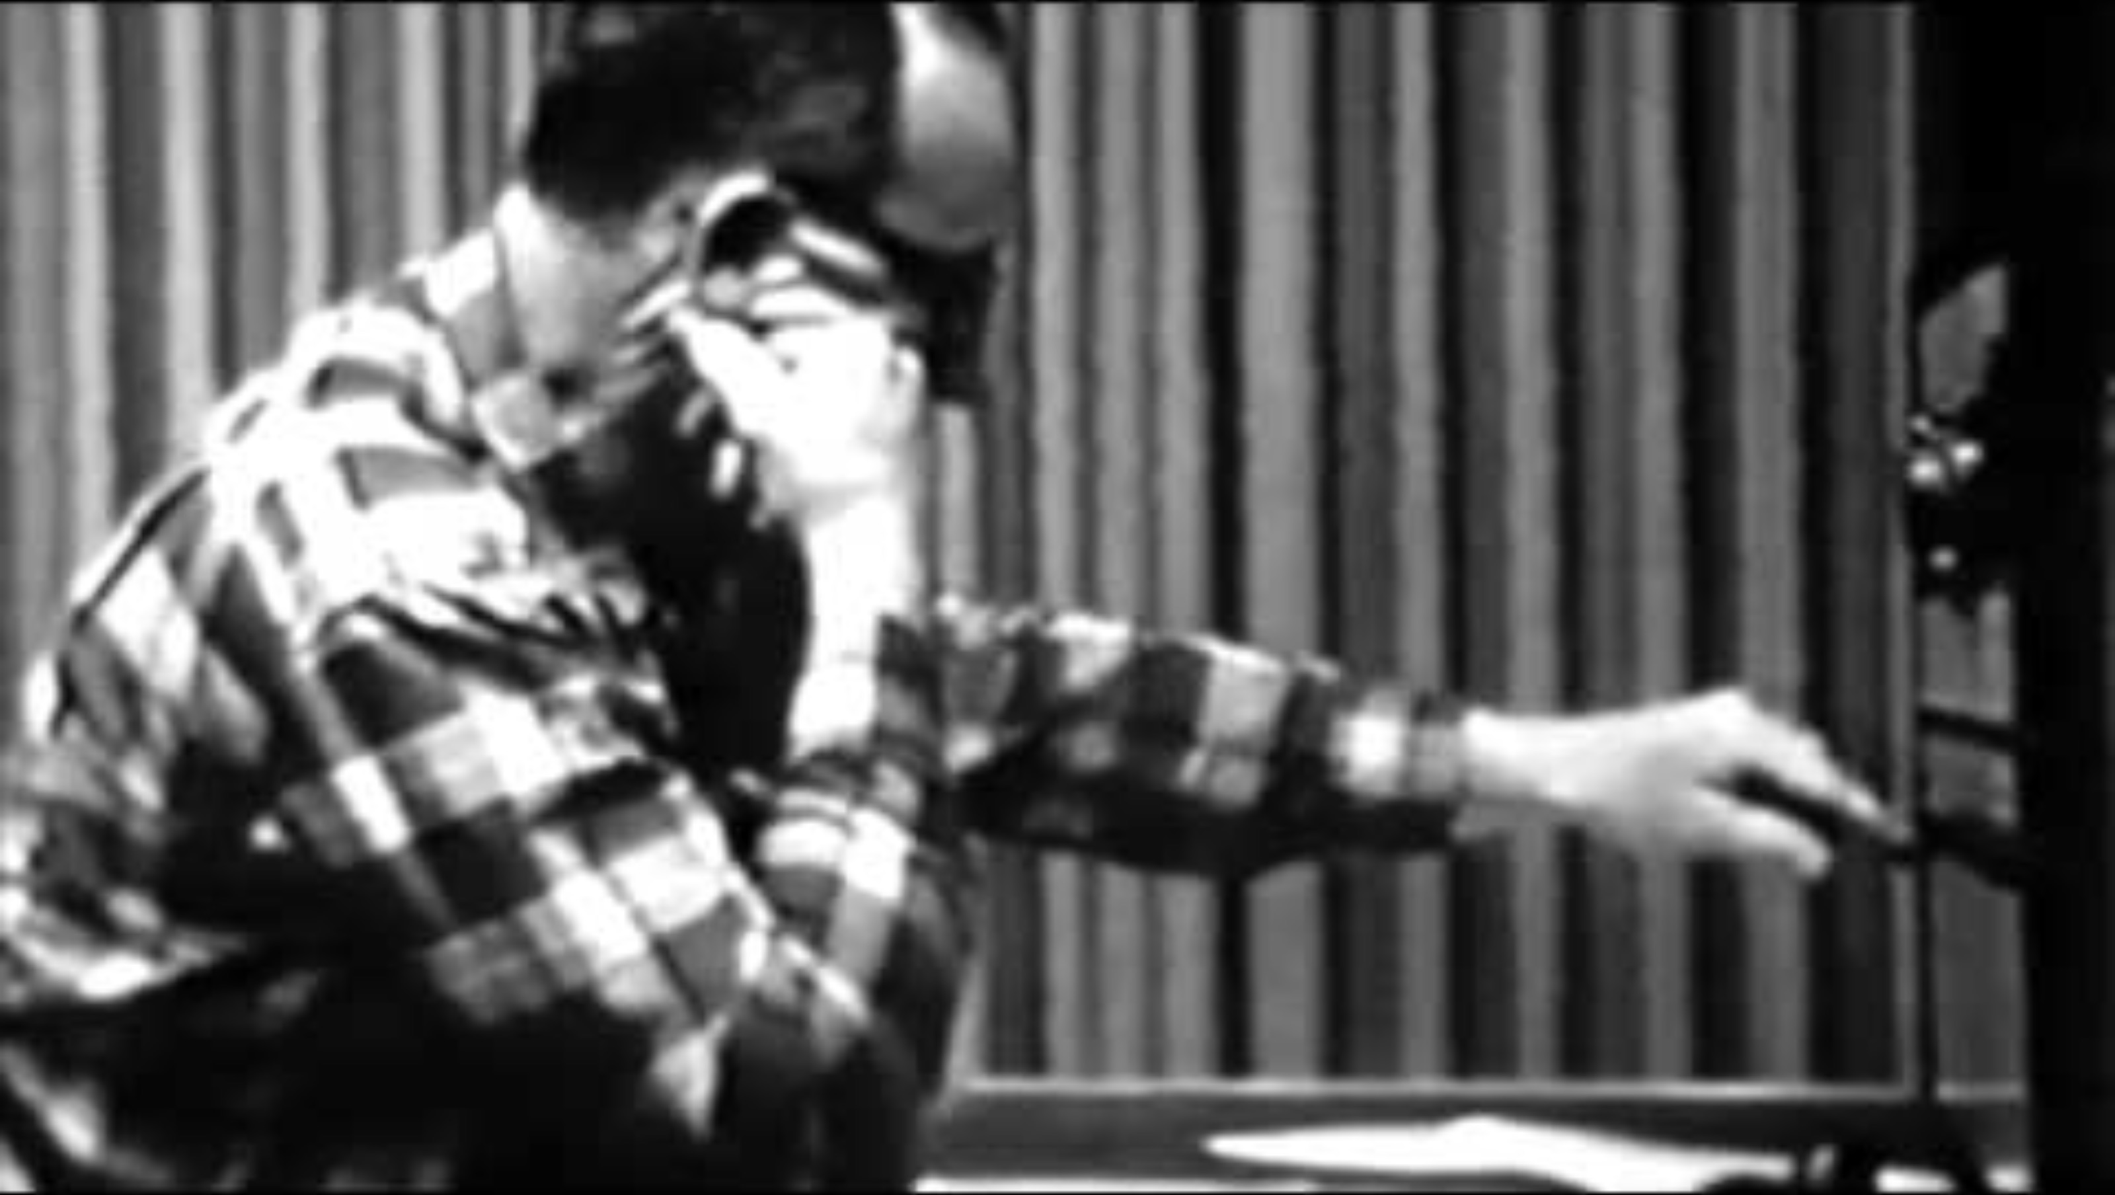
Milgram’s obedience studies (1963)
Notes:
The experiments began 1961 at Yale University, three months after the start of the trial of German Nazi war criminal Adolf Eichmann in Jerusalem.^{[4][5]} Milgram devised his psychological study to explain the psychology of genocide and answer the popular contemporary question: "Could it be that Eichmann and his million accomplices in the Holocaust were just following orders? Could we call them all accomplices?"

Slide 22
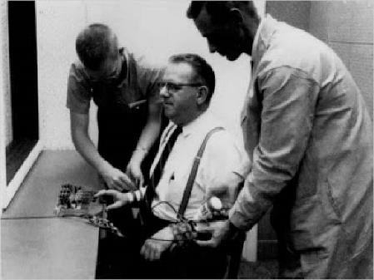
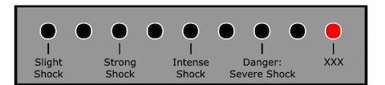
Milgram’s obedience studies (1963)
“Within 20 minutes he was reduced to a twitching, shuddering wreck who was rapidly approaching nervous collapse. He constantly pulled on his ear lobe, and twisted his hands. At one point he pushed his fist to his forehead and muttered ‘Oh God, let’s stop it’. And yet he continued to respond to every word of the experimenter, and obeyed until the end”
Notes:
Student expressed pain, banging on wall, wailing, begging to stop etc.

Slide 23
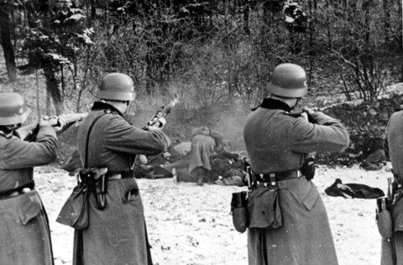
Milgram’s obedience studies (1963)
The social contract: People are willing to follow the instructions of a legitimate authority. Participants had agreed to help to experimenter. Breaking that social commitment is difficult.
The escalation of commitment (consistency effect): Lack of decision points – when do you say no? How can you say no to 240V when you’ve complied to 220V?
The ‘Agentic State’: People concede responsibility and allow themselves to become the agent of another’s will.
Human nature cannot be counted on to isolate man from brutality at the hands of his fellow man when orders come from what it perceived to be a legitimate authority. Stanley Milgram
Notes:
So what was going on?
Social contract: Participants had agreed to help to experimenter. Breaking that social commitment is difficult. Commitment to this social contract also escalates (foot in the door technique)
Escalation of commitment: stopping invites cognitive dissonance.
Agentic state – solution to cognitive dissonance – they can maintain the social contract, they can maintain consistency in their behaviour, without needing to accommodate the belief that they’re amoral psycholpaths. (I don’t make the rules/following orders etc/not responsible).
Some support of this in Milgram’s studies. E.g. when highlighting participants own responsibility, people quit earlier. When reiterating the experimenter is responsible, obedience continues.
Related to post WWII origins of this research.

Slide 24
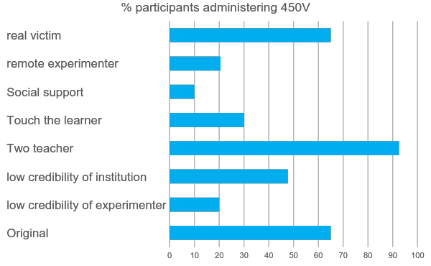
Milgram’s obedience studies (1963)
Notes:
But we also now know of different approaches we can take to reduce this level of pathological obedience: For example:
Bottom to top:
Original
Lab-coat wearing experimenter had to leave, taken over by an ordinary member of public
Original was in Yale. Alternative in some old office building, branded as an independent research organisation
Participant could instruct someone else (a confederate) to push the buttons
Had to force the students hand onto the electrical plate
Two other teachers quitting at 150V and 210V respectively
Experimenter giving instructions by phone from another room.
Replicated with a ‘cute, fluffy puppy’ receiving real shocks – similar results to original. Females more obedient, but more distressed.

Slide 25
Social influence
Real-world examples
Marketing: Social proof is employed when advertisements feature endorsements from celebrities or influencers to persuade consumers to buy products.
Social media: Platforms leverage social influence by showcasing likes, shares, and followers.
Peer Pressure: Individuals conform to group norms or behaviours to fit in or gain acceptance, e.g. smoking or drinking
Fashion: People tend to dress according to what their peers dress
Notes:
Marketing: Companies use social influence techniques to shape consumer behaviour. For instance, social proof is employed when advertisements feature testimonials or endorsements from celebrities or influencers to persuade consumers to buy products.
Social media: Platforms like Facebook, Instagram, and Twitter leverage social influence by showcasing likes, shares, and followers.
Peer Pressure: Social influence is prominent in peer groups, where individuals may conform to group norms or behaviours to fit in or gain acceptance. For example, teenagers might engage in risky behaviors like smoking or drinking to align with their peer group's norms.

Slide 26
Reciprocity
The social norm obliging repayment of favours, gifts, invitations, etc.

Slide 27
Reciprocity
Evolutionary perspective
Unconditional altruism exists among kin. For everyone else, we’ve evolved a tendency toward cooperative behaviour and conditional altruism, based on reciprocity. This allows:
  Division of labour and economic transaction
  Long-term relationships of mutual benefit
  Sharing of spoils (smoothing of resource peaks)
  Teamwork and cooperation in conflict
  Weeding out of freeloaders
Notes:
Altruism exists among kin , since they share our genes, and it is evolutionarily acceptable to expend effort on their wellbeing with nothing in return (assuming cost to us is justified by benefit to kin with a multiplication factor for genetic relatedness).

Slide 28
Reciprocity
Evolutionary perspective
Three innate instincts:
  To help others where the cost is justified by the debt we are now owed and the benefit to our reputation
  To reciprocate favours (avoidance of freeloader reputation)
  To shun or punish those who freeload (or at least avoid future transactions)
Notes:
Altruism exists among kin , since they share our genes, and it is evolutionarily acceptable to expend effort on their wellbeing with nothing in return (assuming cost to us is justified by benefit to kin with a multiplication factor for genetic relatedness).

Slide 29
Reciprocity
Types
Direct reciprocity:
A helps B -> motivates B to help A
Indirect reciprocity:
Upstream: A helps B -> motivates B to help C
Downstream: A helps B -> motivates C to help A
Notes:
Reciprocal ‘Altruism’ to strangers, whereby there is a cost to us and a benefit to someone else (i.e. we make the first move of kindness, and it’s to non-kin) has evolved because it increases our odds of receiving a similar favour in the future. The benefits outweigh the costs because the initiating agent can choose when to provide the favour (when resources are plentiful or risks are low), but can ask for a favour when most in need. It’s a way of saving up good fortune and favours for a rainy day.
Given the benefits of indirect (or network) altruism, you don’t need to expect a favour in return from the same person, to justify the original cost of the favour.
It makes less sense to be altruistic when there is no chance of a repeated scenario where you might reap the benefits. However, our proximal motive (psychological motive) to be kind does not make that distinction, even if the ultimate motive (to service ad flourish) does. This may be because non-repeated scenarios, and scenarios in which we can be mean without damaging our reputation, are so rare in the real world.
upstream, based on B’s need to build a reputation, at risk of being a freeloader)
downstream, based on good reputation of A)

Slide 30
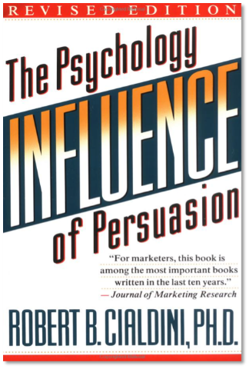
Cialdini’s 6 Weapons of Influence
Authority
We tend to comply with legitimate authority
Social Proof
Informational influence, peers are a source of information
Reciprocity
We feel obliged to respond in kind to favours
Liking
Reciprocity of liking/kindness, and normative influence (need to be liked/accepted)
Commitment & Consistency
Social contracts, & consistency of our own behaviour
Scarcity
Signals popularity & innate hoarding
Notes:
Putting it all together we have Robert Cialdine the psychology of persuasion:
Authority – we tend to obey a legitimate authority & give up personal responsibility. E.g. we do anything we’re told by someone in a high-vis jacket.
Liking – related to reciprocity (reciprocity of liking/kindness) and normative social influence (need to be liked/accepted). E.g. charming salesman.
Social proof – informational social influence. We use others as a source of information to inform our own beliefs. Modern example of music track downloads/ online reviews.
Commitment & consistency - social commitment – feel obliged to do what we told someone we’d do (e.g. Milgram). E.g. we’re more likely to go tot the gym if we’ve agreed to go with someone. Consistency – if we’ve behaved a certain way we will probably continue to do so (we don’t like to contradict ourselves, consistent perception of ourselves). E.g. escalation of comittment (Milgram, boiling frog), and more generally, our behaviour dictating future beliefs and behaviour, e.g. signing up to a charity petition makes us more likely to subsequently donate.
5. Reciprocity – we feel obliged to respond in kind to favours. E.g. free samples encourage us to buy.
6. Scarcity – Less of something signals its popularity (normative & informational influence), but we’re also predisposed towards hoarding scarce resources. E.g. ‘only 7 seats left’. Also, black friday. Madness.

Slide 31
How to apply this to the real-world?
Notes:
Have you ever made an investment decision based on how you feel about a company, its products, or its leadership?

Slide 32
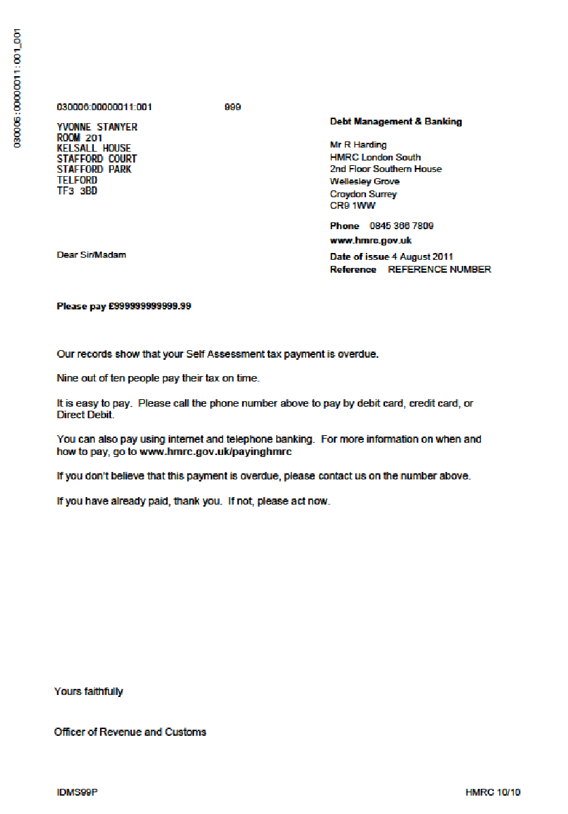
Nudging with descriptive social norms
Nine out of ten people pay their tax on time.

Slide 33
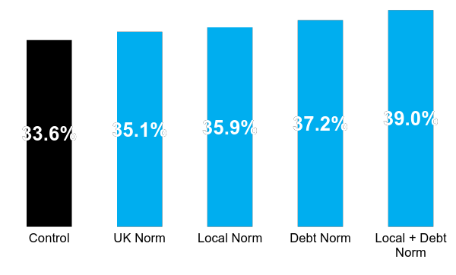
Social norms increased tax payment rates
This trial brought forward £200 million in 12 months.

Slide 34
Social norms encouraged environmental friendly behaviours
Most previous occupants of this room reused their towel at least once during their stay
Reuse your towel to save the environment
Most hotel guests reuse their towel at least once during their stay
35.1%
44.1%
49.3%
Notes:
In recycling, when a hotel room contained a sign that asked people to recycle their towels to save the environment, 35.1% did so. When the sign used social norms and said that most guests at the hotel recycled their towels at least once during their stay, 44.1% complied. And when the sign said that most previous occupants of the room had reused towels at some point during their stay, 49.3% of guests also recycled.47

Slide 35
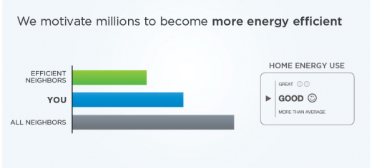
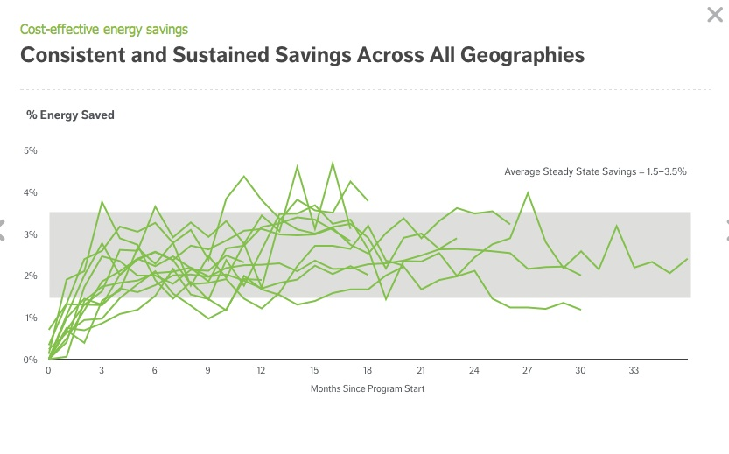
Social comparison to reduce energy consumption
Sustained 2% saving, and 3-5% peak reduction.
3 million tonnes of CO2 if rolled out across 149m EU homes (equivalent to planting 150 million trees)

Slide 36
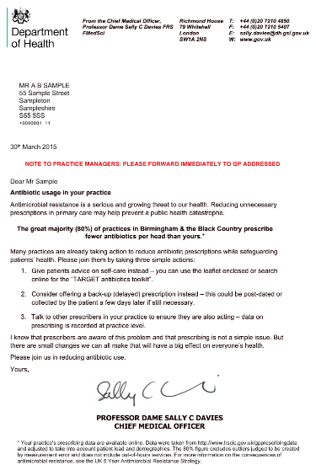
“The great majority (80%) of practices in London prescribe fewer antibiotics per head than yours.”

Slide 37
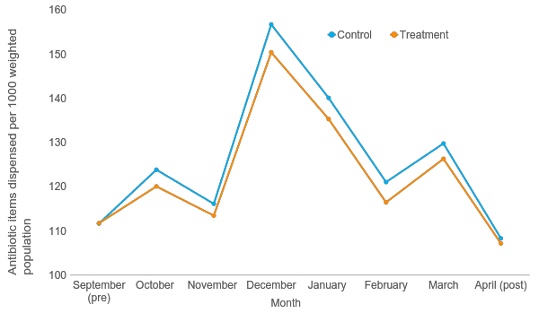
Social norms reduced prescriptions rates
Notes:
… before diverging as the letters are received. Note: all differences between the groups are statistically significant every month (largest p value is 0.0135 – see table to the right).
c. 3% reduction
All letters sent out in October
Final April – letters also sent to the control group.
Social marketing campaign also run, with no effect.

Slide 38
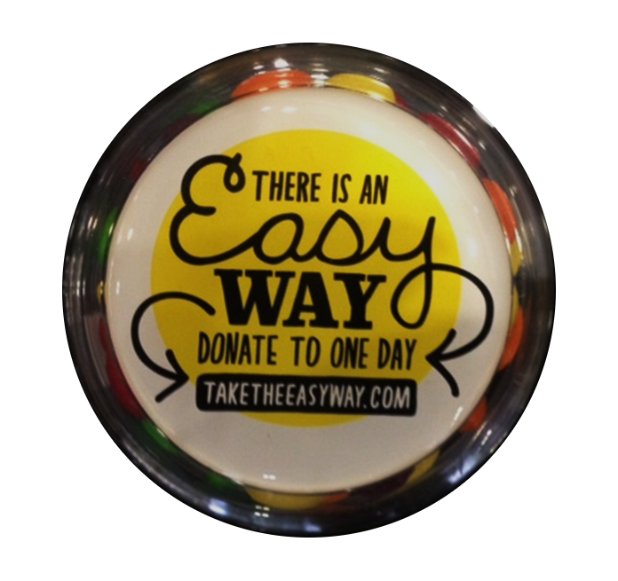
Increasing donations
We worked with a large investment bank to see if we could get their employees to donate a day’s worth of salary to charity. We tried a few different things:
Getting a minor celebrity to ask them to donate
Giving them candy
A personalised email sent from the CEO
Notes:
We worked with a large investment bank to see if we could get their employees to donate a day’s worth of salary to charity. To do this, we tried a few different things:
1 - Getting a minor celebrity to ask them to donate
2 - Giving them candy
3 - A personalised email sent from the CEO
It’s a pretty hierarchical organisation… so what do you think worked best?

Slide 39
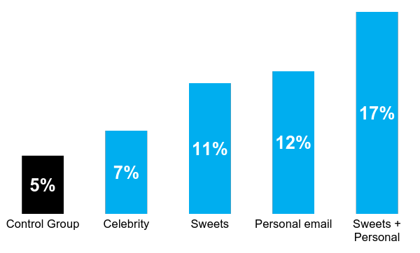
Nudging with reciprocity
Proportion giving away a day’s salary to charity
Notes:
Well, it turns out that celebrities aren’t that useful – something that many charities would be very surprised to hear, I expect! Candies and an email from your boss are about as powerful as one another and together they make a dream team! There are two things going on: one is expected – we do things people we want to impress ask us to, particularly when it’s as easy as clicking a link in the email.
The second is less obvious and links to commitment – we seek to reciprocate when someone gives us something. This isn’t altruism – the difference from the control is explained by these guys getting an inexpensive bag of sweets and paying back the favour with a £1800 donation!
What’s incredible is that the impact of those candies are not significantly different from the impact of a personal email from your boss. The two of them together, however, are all powerful.
Clearly giving sweets out is not a policy solution but considering ways in which we pull out the notion of reciprocity and work with it are completely viable.
When we think about incentives, we should go beyond the simple lens of monetary reward or sanction.

Slide 40
Nudging with reciprocity
We got bankers to donate £500,000 to charity in one day.
Notes:
Let’s move on to our next example of how to make it attractive?
We worked with a large investment bank to see if we could get their employees to donate a day’s worth of salary to charity. To do this, we tried a few different things:
1 - Getting a minor celebrity to ask them to donate
2 - Giving them candy
3 - A personalised email sent from the CEO
It’s a pretty hierarchical organisation… so what do you think worked best?

Slide 41
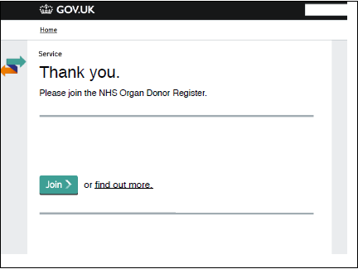
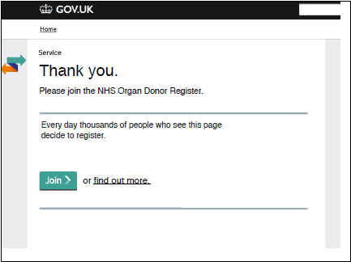
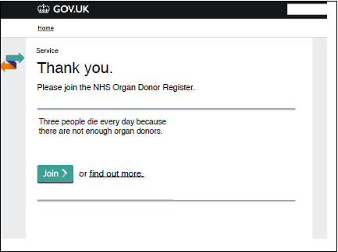
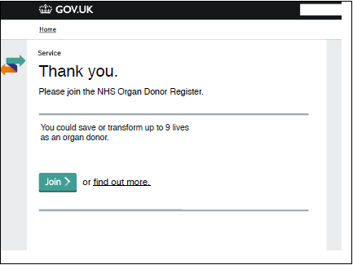
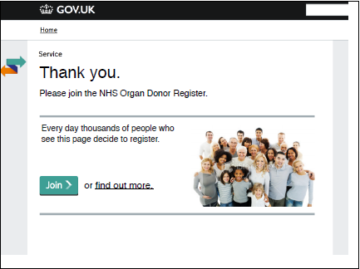
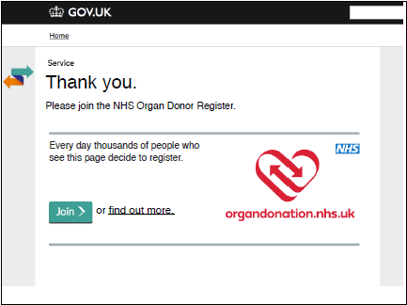
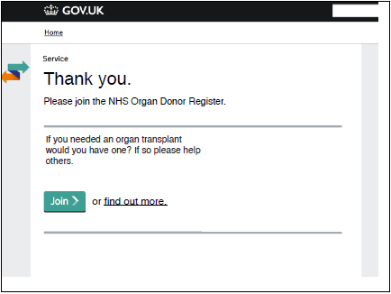
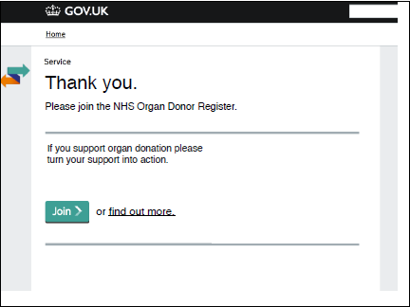
Encouraging organ donations
1. Control
2. Norm
5. Three Die
6. Nine Lives
3. Norm & Picture
4. Norm & Logo
7. Reciprocity
8. Action
Notes:
End of tax-disc registration, asked if they’d like to join the organ donor registration.

Slide 42
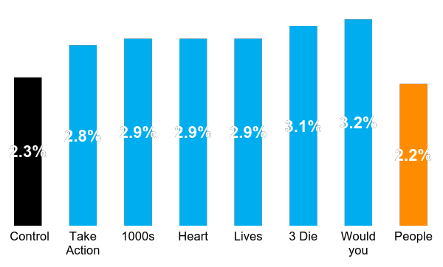
Encouraging organ donations
Proportion joining the organ donor registry after a simple online prompt
This organ donation trial will add 100,000 organ donor registrations in one year.
Notes:
Elicits the sense of reciprocity & obligation, by saying ‘other people have done this for your (potential) benefit.
Doesn’t rely on actually giving something to the person.

Slide 43
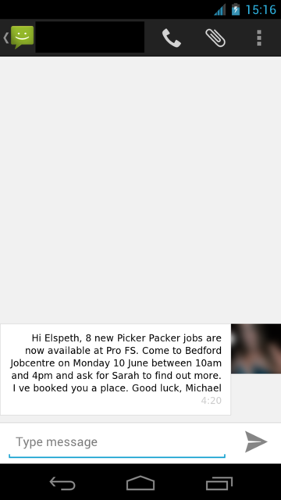
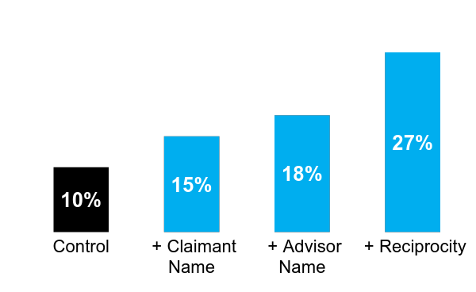
Reducing unemployment
% of job seekers turning up to the Jobcentre
Notes:
Jobcentres often coordinate recruitment for large employers locally. For example, a large supermarket may be opening in the area, and need to hire 100 new staff. Jobcentres typically run a brief service dedicated to helping people apply for these jobs (e.g. fill in an application form) and then submit the suitable applications in bulk. But attendance of this services was low and one or two days of advisor time may be used unproductively in waiting for jobseekers to attend. As this is supplementary to jobseekers’ requirement to attend, JCP has little power to compel individuals to come to the sessions.
Conclusion: Text messages that use reciprocity (“I’ve helped you, can you do something for me?”) are highly effective
Principles:
MAKE IT PERSONAL
RECIPROCITY

Slide 44
Common mistakes when using social norms
Notes:
Have you ever made an investment decision based on how you feel about a company, its products, or its leadership?

Slide 45
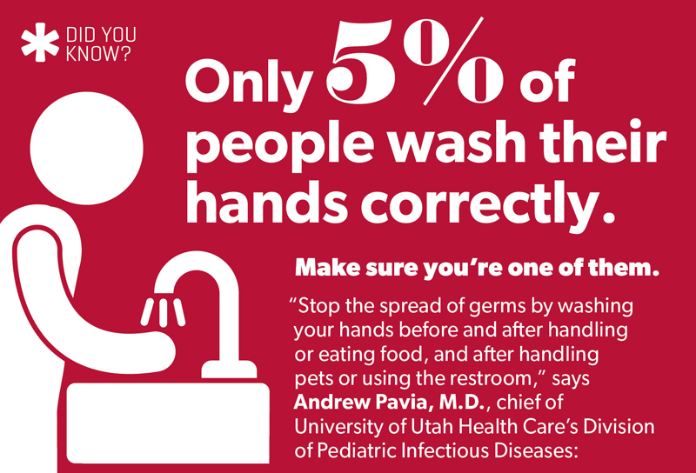
Advertising the bad descriptive norm can backfire

Slide 46
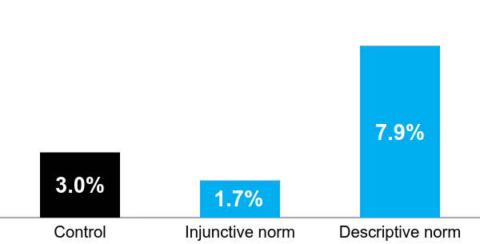
Advertising the bad descriptive norm can backfire
“Please don’t remove the petrified wood from the Park, in order to preserve the natural state of the Petrified Forest.”
“Many past visitors have removed petrified wood from the Park, changing the natural state of the Petrified Forest.”
“Your heritage is being vandalized every day by theft losses of petrified wood of 14 tons a year, mostly a small piece at a time.”
Percentage of petrified forest wood stolen
Source: Cialdini (2003) Crafting normative messages to protect the environment

Slide 47

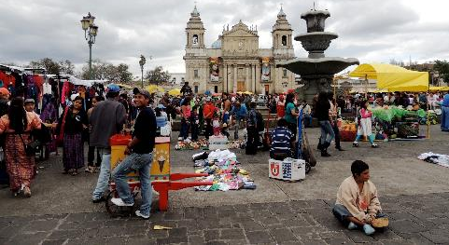
The norm needs to correct prior beliefs
“90% of people pay their tax on time…”
No change in payments
“65% of people pay their tax on time…”
Significant increase in payments
Notes:
In Singapore, 90% might seem quite low, perhaps lower than people’s prior assumption, so it has no benefit.
In Guatemala, 65% is actually much higher than most people assume.

Slide 48
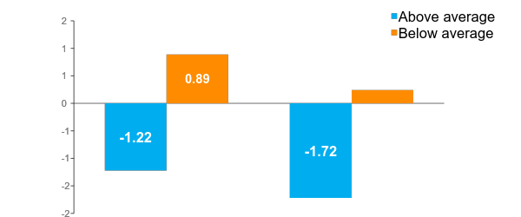
A descriptive norm can create a ‘boomerang effect’
Change in energy consumption per day (kWh)
Source: Schultz et al. (2007) The constructive, deconstructive and reconstructive power of social norms

